Slide 1
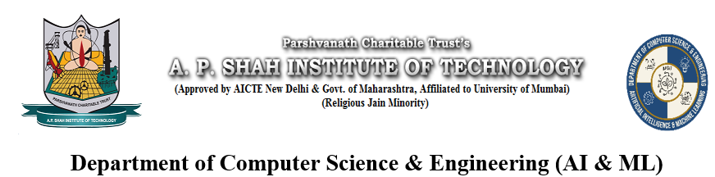
NEARY
Theme- SDG Goal 11 <sustainable cities and communities>
Category- Software
Group No - 11
Group Members- Palak Jain, Arya Jain, Preksha Jain.
Guide- Prof. Poonam Tiware
Notes:
‹#›

Slide 2
Introduction
Background
Difficulty in finding reliable and verified local help
Affects students, newcomers, and urban residents
Causes delays in completing everyday tasks
Leads to lack of trust in service quality
Results in inefficient use of local resources
Becomes critical in emergencies due to slow access to nearby help
Key Challenges in Modern Cities
Weak local support networks
“Social distance” in urban life
Trust and reliability issues
Connectivity gaps in communities
Notes:
‹#›

Slide 3
Motivation
Inspired by SDG 11
Focus on access and safety
Reduce harassment in public spaces
Use technology for urban cohesion
Strategic Objectives and Contributions
GPS-based local helper ecosystem: Connects users with nearby helpers based on real-time location.
Real-time service tracking: Allows users to monitor task progress and helper status live.
AI-based SOS emergency alerts: Enables instant, hands-free emergency assistance using AI triggers.
Verified and trustworthy network: Ensures safety through admin verification and user ratings.
Efficient resource sharing: Optimizes use of local skills and services within the community.
Notes:
‹#›

Slide 4
Survey of Existing Solutions in India
Urban Company – home services: Provides on-demand professional services like repairs, beauty, and maintenance at home.
Porter – hyperlocal delivery: Enables quick transportation of goods and errands within the city.
Snabbit – local services: Offers convenient access to nearby service providers for daily needs.
NoBrokerHood – community management: Manages security, visitors, and communication within residential societies.
Govt apps – Himmat, Nirbhaya (SOS): Offer emergency alert systems to quickly contact police and ensure user safety.
Notes:
‹#›

Slide 5
Analysis of Weaknesses and Limitations
Service marketplaces: Often face inconsistent quality and lack reliable real-time tracking for accountability.
Hyperlocal platforms: Depend heavily on gig workers, causing inefficiency and limited availability during peak times.
Community management apps: Compromise user data privacy while focusing on physical security.
Personal safety apps: Have high dropout rates due to battery drain and low user engagement.
Current systems: Rely only on alerts and fail to provide immediate real-world assistance.
Notes:
‹#›

Slide 6
Survey of Methodologies and Techniques
SERVQUAL model: Evaluates service quality using reliability, responsiveness, assurance, tangibles, and empathy.
Algorithmic management: Automates task allocation and monitors worker performance using real-time data.
Task automation: Uses OTP-based start/end codes to manage tasks efficiently without manual intervention.
Mobile frameworks: Flutter and React Native enable high-performance, cross-platform apps with GPS integration.
Notes:
‹#›

Slide 7
Limitations of existing Systems
Static crisis response: Safety apps rely on passive alerts and fail to provide immediate real-world assistance.
Security & trust issues: Centralized systems risk data breaches and create a lack of trust due to poor verification.
Technical inefficiency: Outdated algorithms cause high latency, battery drain, and unreliable performance.
Operational instability: Poor matching systems ignore helper fatigue, leading to high turnover and instability.
Notes:
‹#›

Slide 8
Problem statement
Proposed Methodology
Difficulty in finding reliable and verified nearby help
Affects students, newcomers, and urban residents
Creates delays in daily tasks and emergency response
Leads to lack of trust in service providers
Causes inefficient use of local community resources
Gap between physical proximity and social accessibility
Limited connectivity within local communities
Increases risk during emergency situations
Backend: Built using Python with Flask for routing and server-side logic
Frontend: Developed using HTML, CSS, and JavaScript for user interface
Database: Uses SQL Workbench for data storage and management
Active local mobilization: Creates a 500m helper network for instant SOS response
Privacy-first verification: Ensures safety through admin-based user verification
Stability-focused matching: Balances workload to prevent helper burnout and ensure system stability

Slide 9
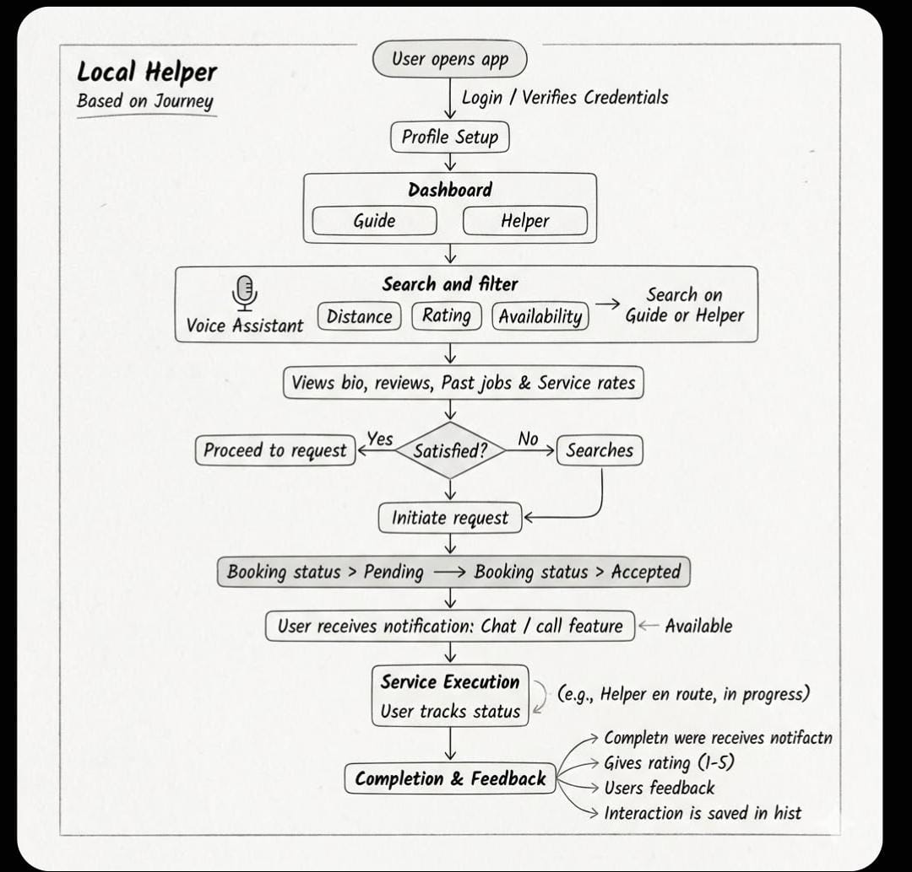
Notes:
‹#›

Slide 10
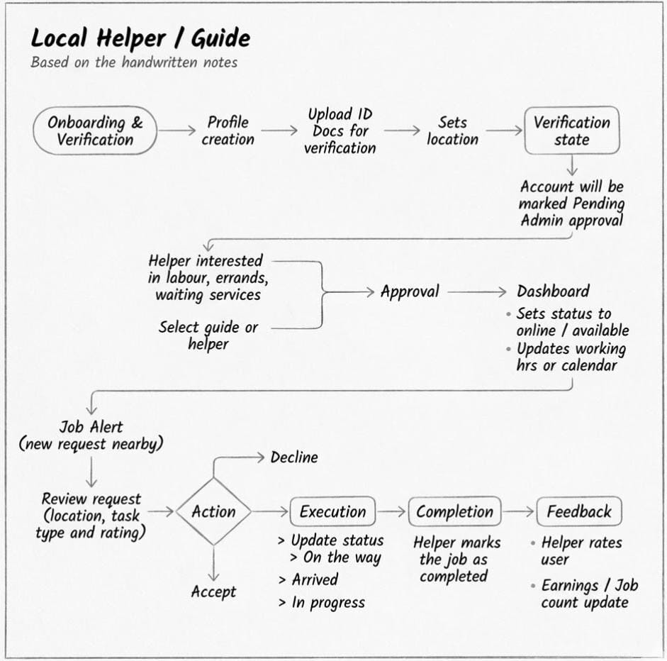
Notes:
‹#›

Slide 11
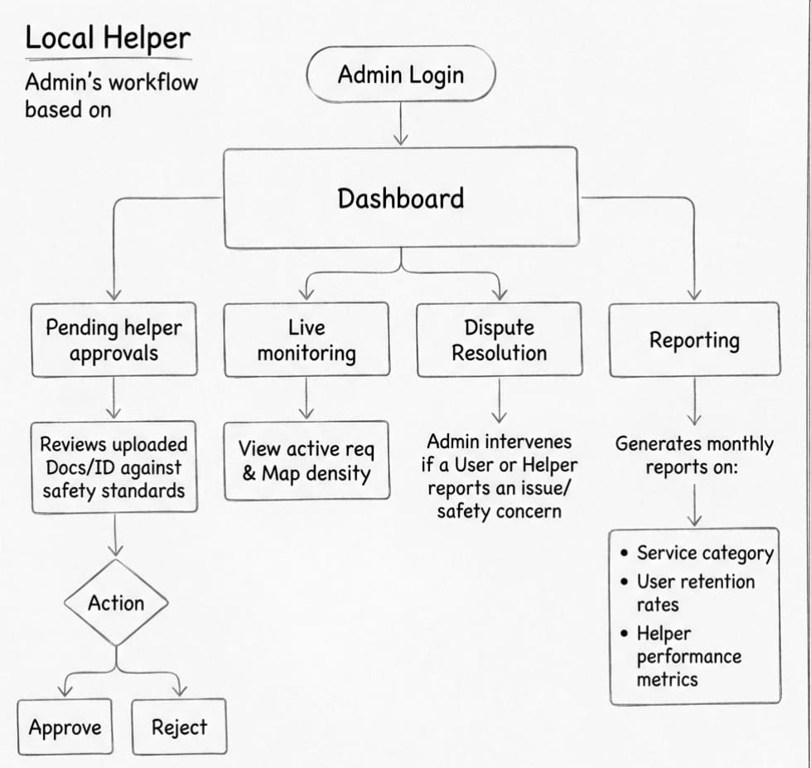
Notes:
‹#›

Slide 12
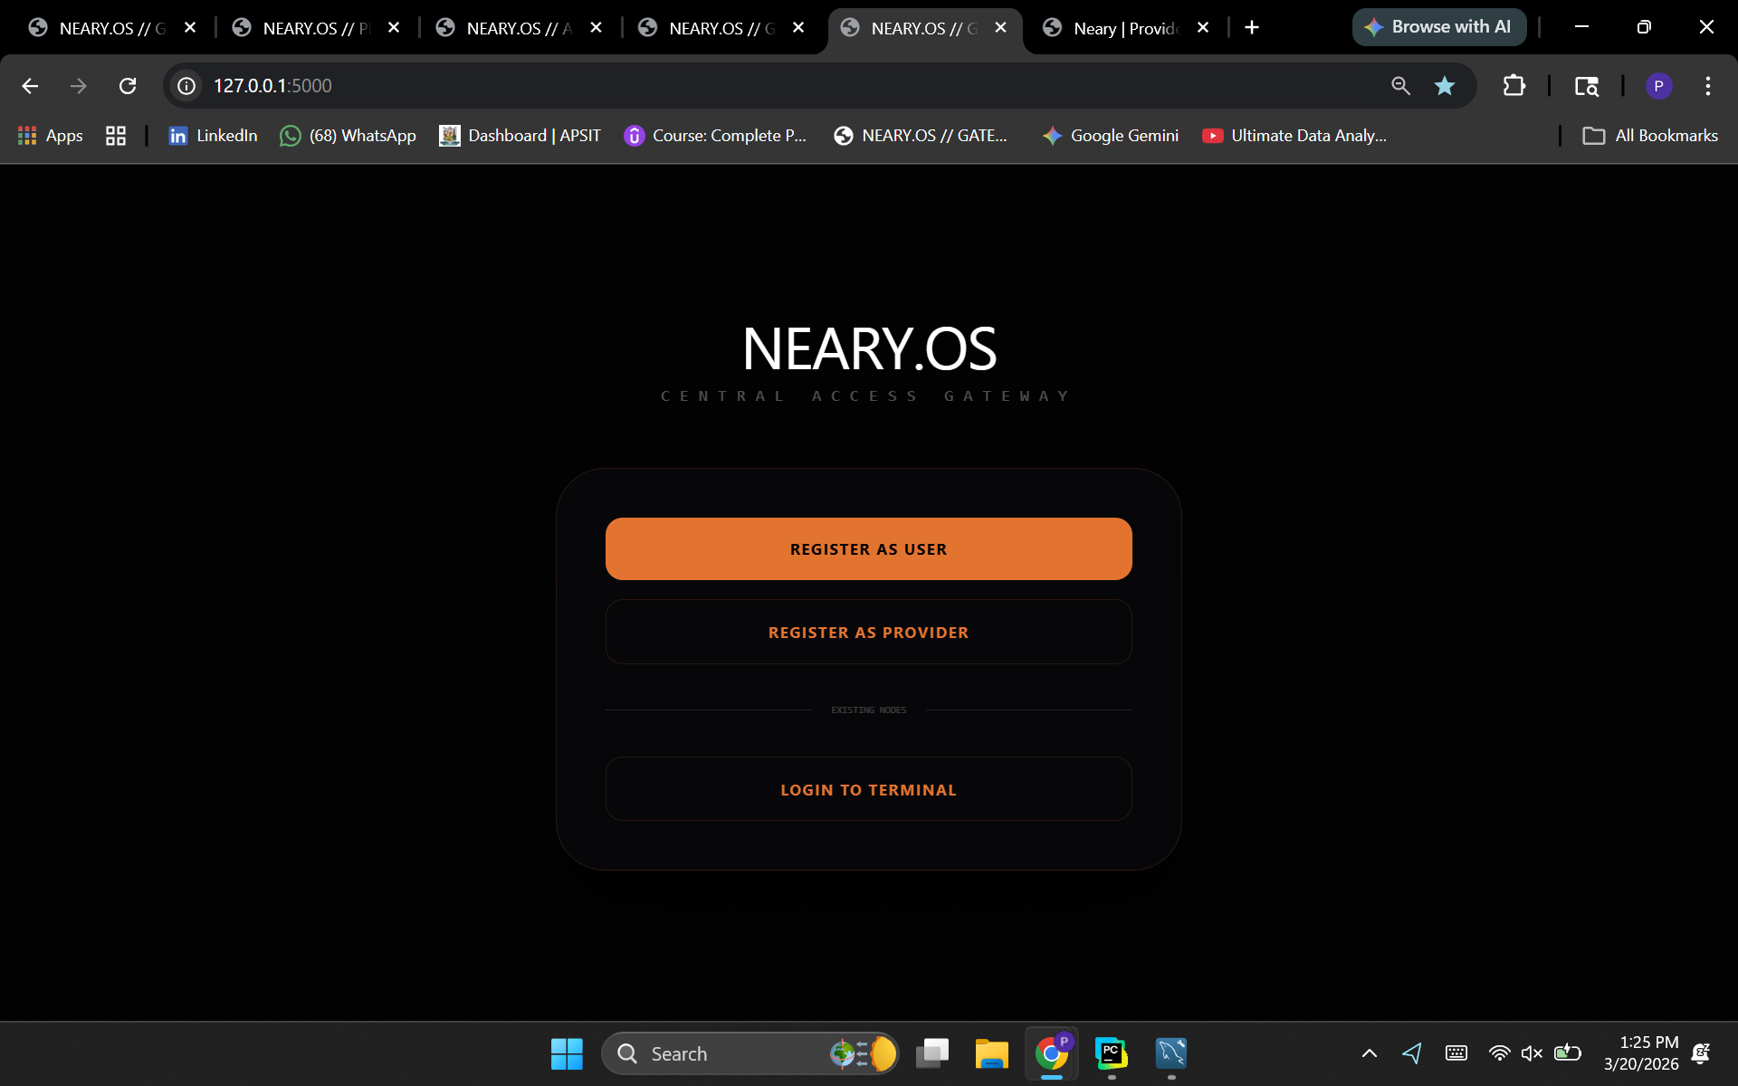
Implementation

Slide 13
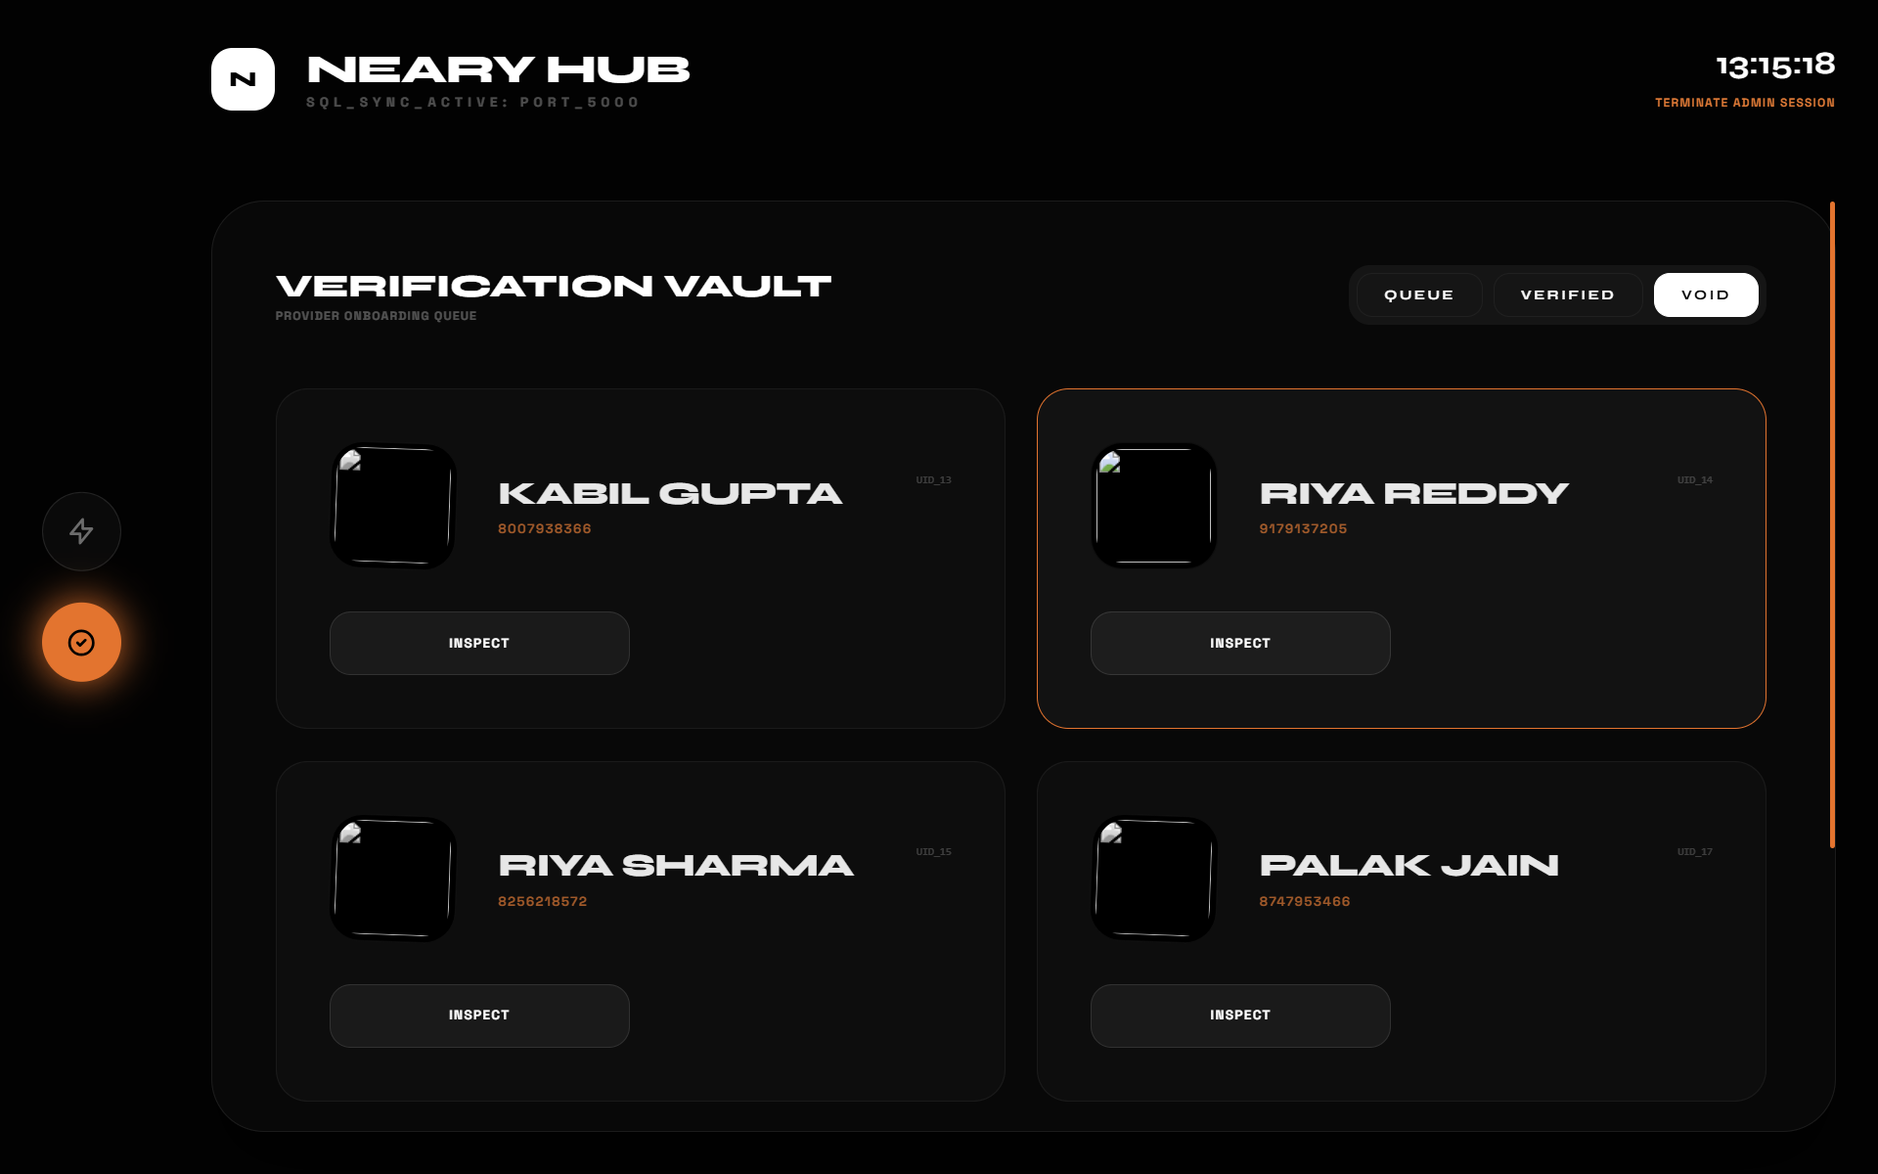

Slide 14
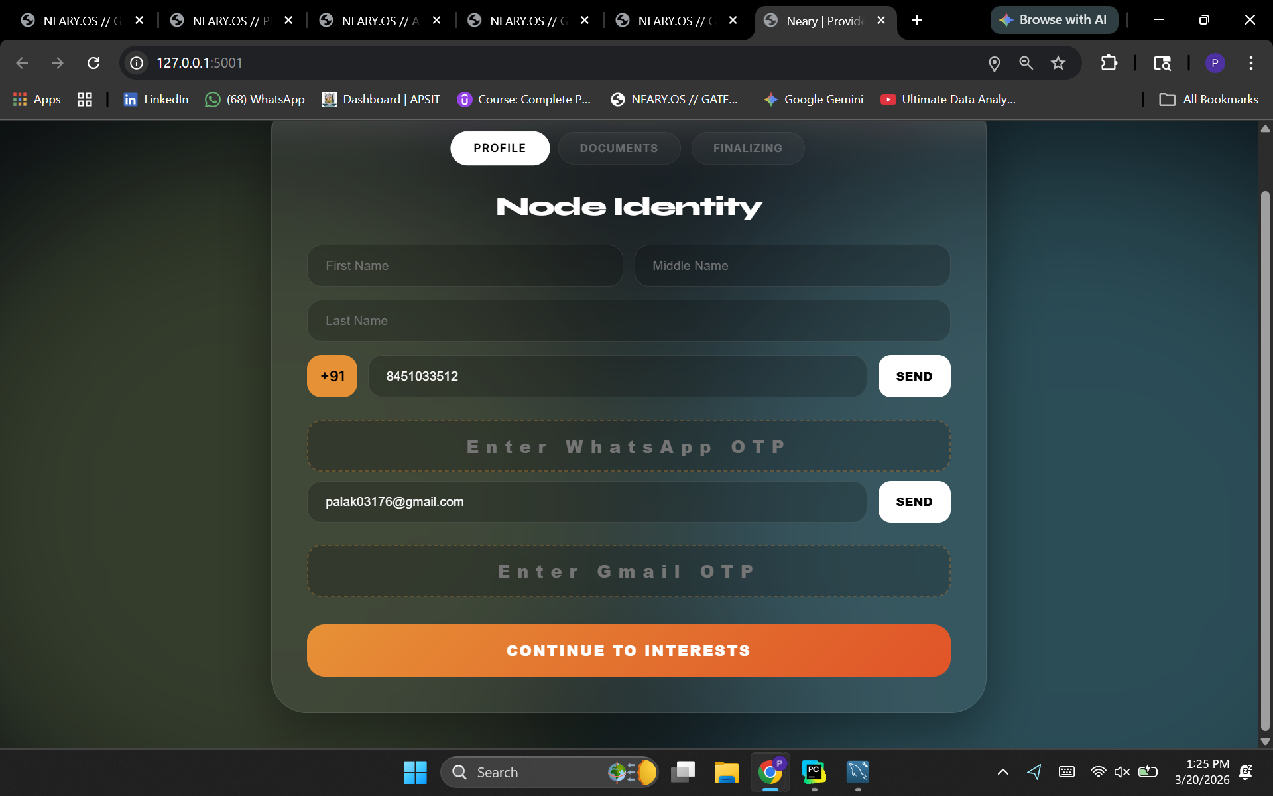

Slide 15
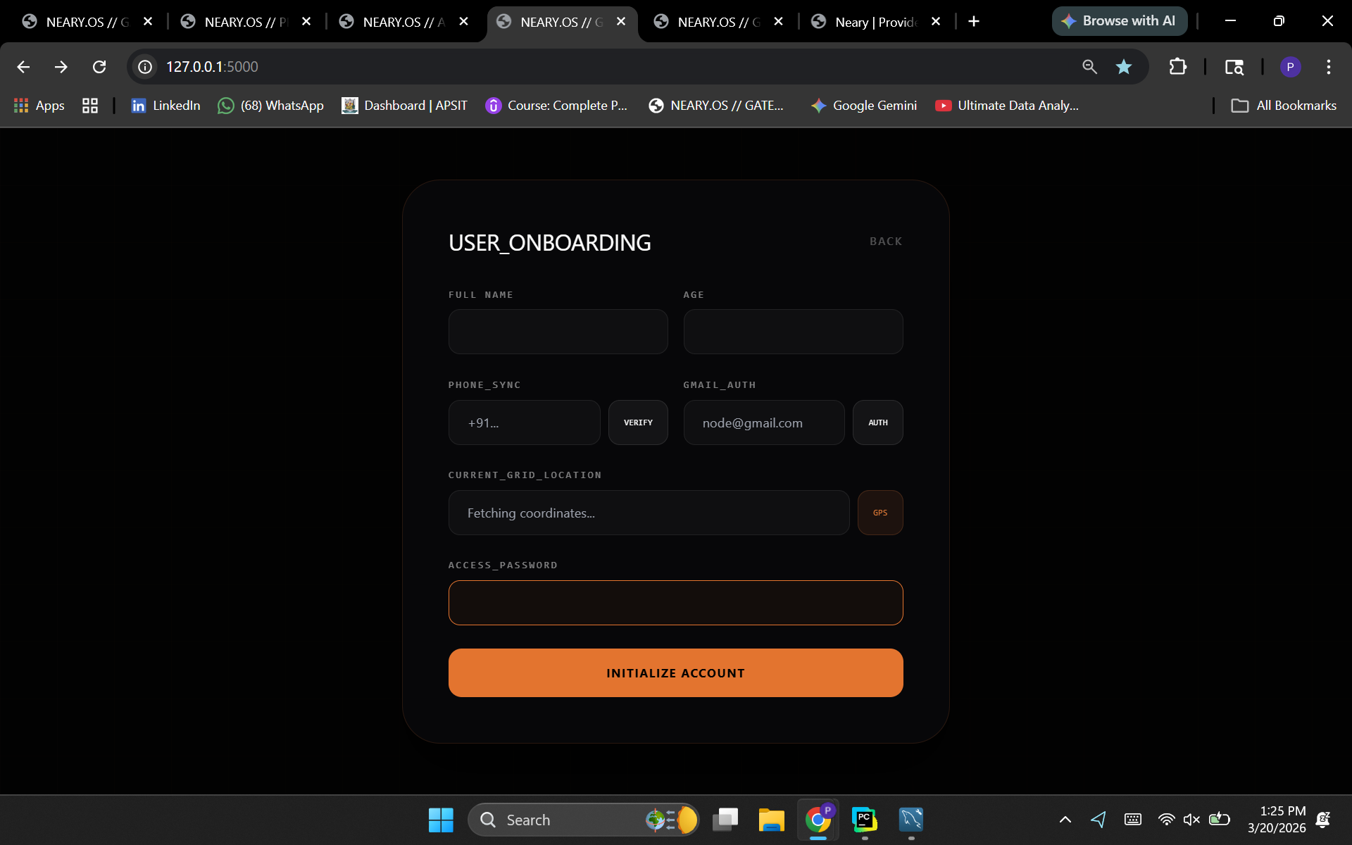

Slide 16
Results & Analysis
Functional system: Successfully connects users with verified local helpers using GPS
Key features: Includes registration, location-based search, tracking, chat, and ratings
Trust & efficiency: Admin verification and AI matching improve safety and performance
Problem solving: Reduces delays, builds trust, and improves resource utilization
Faster response: Location-based matching decreases response time significantly
Better transparency: Real-time updates and ratings enhance user confidence
Scalable tech: Tech stack supports performance and cross-platform compatibility
Challenges identified: Privacy, availability, and service quality issues exist
Solutions proposed: Secure authentication, controlled onboarding, and incentives
SDG alignment: Promotes safer, inclusive, and well-connected communities
Notes:
‹#›

Slide 17
Summary of Outcomes
The development of Neary.OS represents a sophisticated integration of academic service quality models and real-time urban management technologies, successfully bridging the gap between local service demands and verified specialist supply through its innovative "Tactical Service Grid." By leveraging the SERVQUAL framework for security via mandatory Aadhaar verification, automated algorithmic management through secure OTP handshakes, and precise GIS-based spatial auditing with Leaflet.js, the platform establishes a high-trust ecosystem that optimizes urban mobility and service delivery.
Scope for Improvement
Localized accessibility: Adds multilingual support to improve usability in diverse regions
Predictive optimization: Uses AI to forecast demand and optimize helper allocation
Blockchain auditing: Ensures secure and tamper-proof tracking of ratings and reliability
Notes:
‹#›

Slide 18
References
United Nations, "Goal 11: Make cities and human settlements inclusive, safe, resilient and sustainable," United Nations Sustainable Development Goals, 2015. [Online]. Available: https://sdgs.un.org/goals/goal11
S. Elizabeth Pravena and M. Bammadi, "A Study on Service Quality with special reference to Urban Company Services, Hyderabad," International Journal of Novel Research and Development, vol. 9, no. 4, pp. c375-c386, 2024. https://ijnrd.org/papers/IJNRD2404275.pdf
A. Surie, "On-demand platforms and pricing: how platforms can impact the informal urban economy, evidence from Bengaluru, India," Work Organisation, Labour & Globalisation, vol. 14, no. 1, pp. 83-102, 2020. doi: 10.13169/workorgalaboglob.14.1.0083
N. Srividya, "Predicting Customer Satisfaction Score (CSS) for Urban Company Utilizing the K-Nearest Neighbours (KNN) Algorithm," Int. J. Intell. Syst. Appl. Eng., vol. 12, no. 22s, pp. 467-476, 2024. [Online]. Available: https://ijisae.org/index.php/IJISAE/article/view/6486
UN Stats, "Indicator 11.7.2: Proportion of persons victim of physical or sexual harassment," SDG Indicators Metadata Repository, 2023. [Online]. Available: https://unstats.un.org/sdgs/metadata/files/Metadata-11-07-02.pdf
P. Sarma et al., "Women Safety App Development using Android Studio and Google Maps API," Indian Journal of Science and Technology, vol. 16, no. SP2, pp. 60-69, 2023. doi: 10.17485/IJST/v16iSP2.8767
K. Viswanath and A. Basu, "Safetipin: an innovative mobile app to collect data on women’s safety in Indian cities," Gender & Development, vol. 23, no. 1, pp. 45-59, 2015. doi: 10.1080/13552074.2015.1013668
Notes:
‹#›

Slide 19
Thank You!
Notes:
‹#›

